Slide 1

>>>>> Before You Begin <<<<<
Less is more
Avoid paragraphs and long sentences
Use the 5x5 rule — max of 5 lines, 5 words each
One idea per slide
Notes:
Esri Corporate Template-Dark v4.1
January 5, 2022

Slide 2

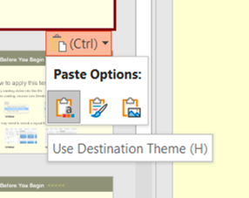
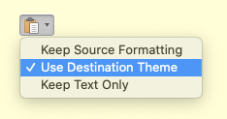
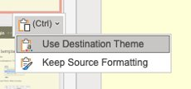
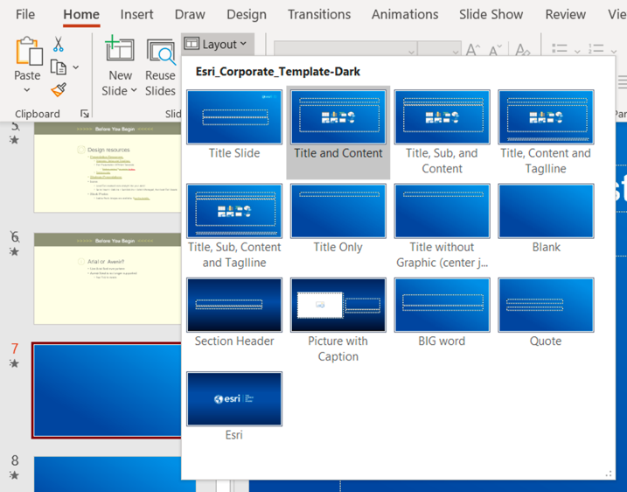
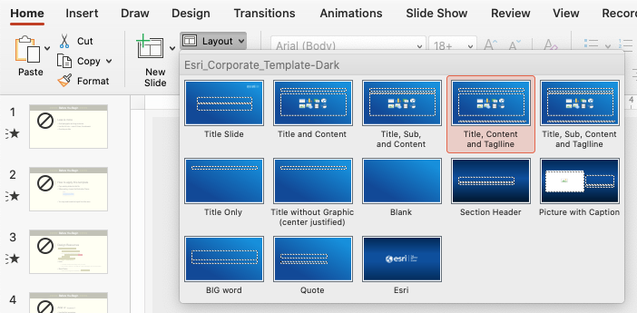
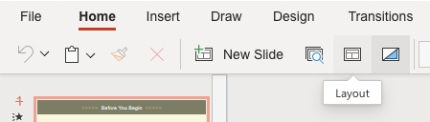
>>>>> Before You Begin <<<<<
How to apply this template
Copy existing slides into this file
When pasting, choose Use Destination Theme
Adjust your slides: titles are now larger and lower on the slide for better visibility
For consistent title placement, you may need to select a layout from the Layout menu
Windows
Mac
Web
Windows
Mac
Web

Slide 3

>>>>> Before You Begin <<<<<
Design resources
Icons
Load Esri-created icons straight into your deck!
From the Home ribbon above, click Esri Icons
Presentation Resources [link]
Diagrams, Tables and Timelines [link]
Esri Design Template [link]
Backgrounds [link]
Strategic Presentations [link]
Stock photos
Adobe Stock images are available. See the details.

Slide 4


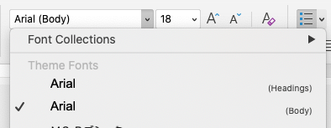
>>>>> Before You Begin <<<<<
Arial or
Use Arial font everywhere
Pick Arial [Headings] or [Body] from the top of the font list
See FAQ “Theme Fonts” for details [link]
Avenir Next is no longer supported
See FAQ “Arial or Avenir Next” for details [link]

Slide 5


ArcGIS Python Overview
Nanae Aubry
Shaun Walbridge
2023 ESRI USER CONFERENCE

Slide 6


Outline
Explosive growth of Python
Python in the ArcGIS Ecosystem
Python in the Desktop Stack
Python in the Enterprise Stack
Python in PaaS
Road Ahead

Slide 7








Explosive growth of Python
Glue language / automation / server-side scripting
Meteoric rise of Python
An explosion in # of scientific computing packages
Python everywhere – astronomy to finance to genomics
Python anywhere – platform agnostic, micropython, Pythonista

Slide 8
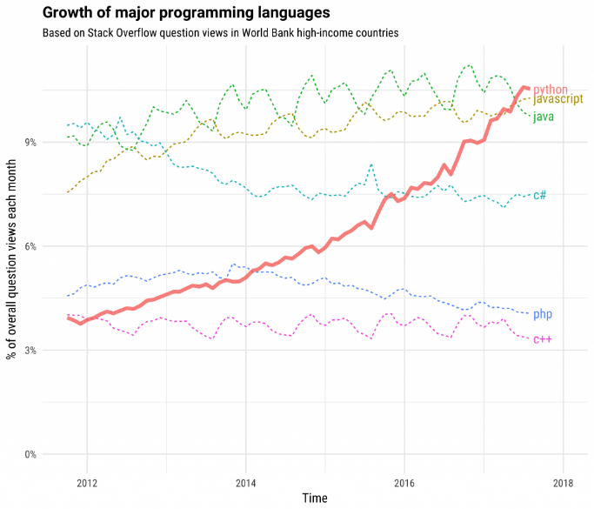

Why Python Matters
It’s what people know
Learn once, use everywhere
Minimize maintenance costs
Language and API consistency
mean less cognitive load
Problems
Technology
https://stackoverflow.blog/2017/09/06/incredible-growth-python/

Slide 9













Python Everywhere
Portal
API for Python
Hosted Notebooks
Insights
Raster Analytics
GeoAnalytics
Enterprise
Pro
ArcPy
Drone2Map
Business Analyst
Workflow Manager
API for Python
Indoors
Desktop
Online
PaaS
AWS Lambda
SaaS / PaaS
Local Server
Local Server
Local Server
Runtime
.NET
Java
Qt

Slide 10



The Growth of Python in ArcGIS
ArcGIS Notebooks
Deep Learning
Data Science
Workstation
Foundational: ArcPy, Pro, REST API
Growth: Deep Learning, Python API, Conda, R
Jupyter Notebooks
Environments in Pro
Geoprocessing tools per release year
Python API for ArcGIS
Conda
SciPy Stack
Python 3 in Pro
Python raster functions
arcpy.da Background Geoprocessing
ArcPy
Python Window

Slide 11
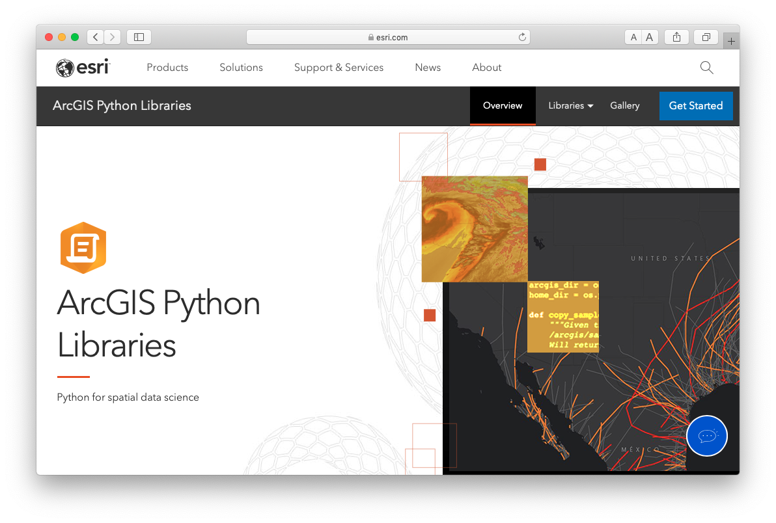

ArcGIS Python Libraries
ArcPy
ArcPy + ArcGIS API for Python
ArcGIS API for Python
Manage online content and tools
Spatial DataFrames
Deploy anywhere
Build geospatial deep learning models
Maps and projects
Deep access to Pro with simple code
1900+ geoprocessing tools
Do everything with Python
Jupyter Notebook rich integration
Seamlessly blend web layers and local analysis
Comprehensive and powerful library for spatial analysis, data management, and conversion.
Lightweight library for analyzing spatial data, managing your Web GIS, and performing spatial data science.
Pro
Enterprise
Cloud

Slide 12

Python in the Desktop Stack
Shaun Walbridge
Pro
ArcPy
Drone2Map
Business Analyst
Workflow Manager
Indoors
Desktop

Slide 13
ArcPy
Supported in Desktop, Pro, Server and Notebooks
Maps and Projects:
arcpy.mp
CIM access
Access the work of most Pro teams, such as:
arcpy.nax
arcpy.ia
arcpy.metadata
Build Python tools and toolboxes which control all aspects of Pro
Integrate everything locally, publish to Services
Schedule jobs (Geoprocessing Scheduler, Windows Tasks)

Slide 14
A public service announcement on Python versions
Python 2:
Python.org support has ended
Upstream package support has largely ended
ArcGIS 10.x Desktop
ArcGIS Server 10.x is deprecated
Esri: Long term support for security only
Python 3:
Pro, ArcGIS API for Python, Server Pro Runtime, Hosted Notebooks
All current and future development work
Have ArcMap / Python 2 code? Analyze Tools for Pro

Slide 15
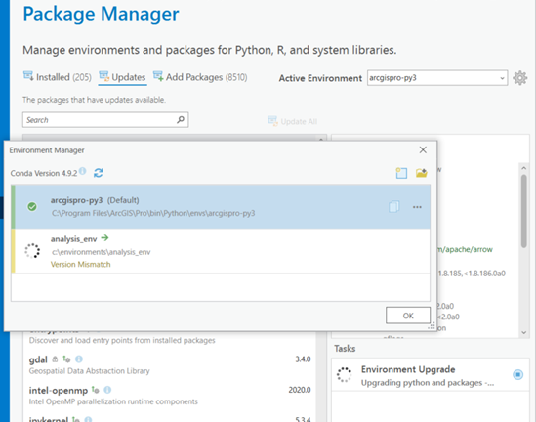
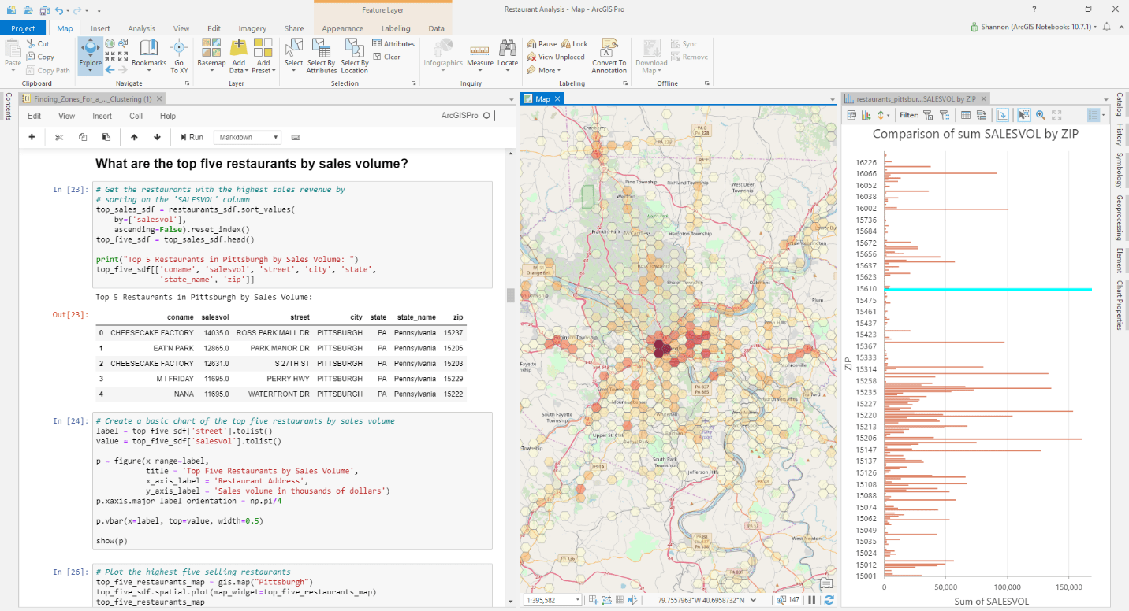
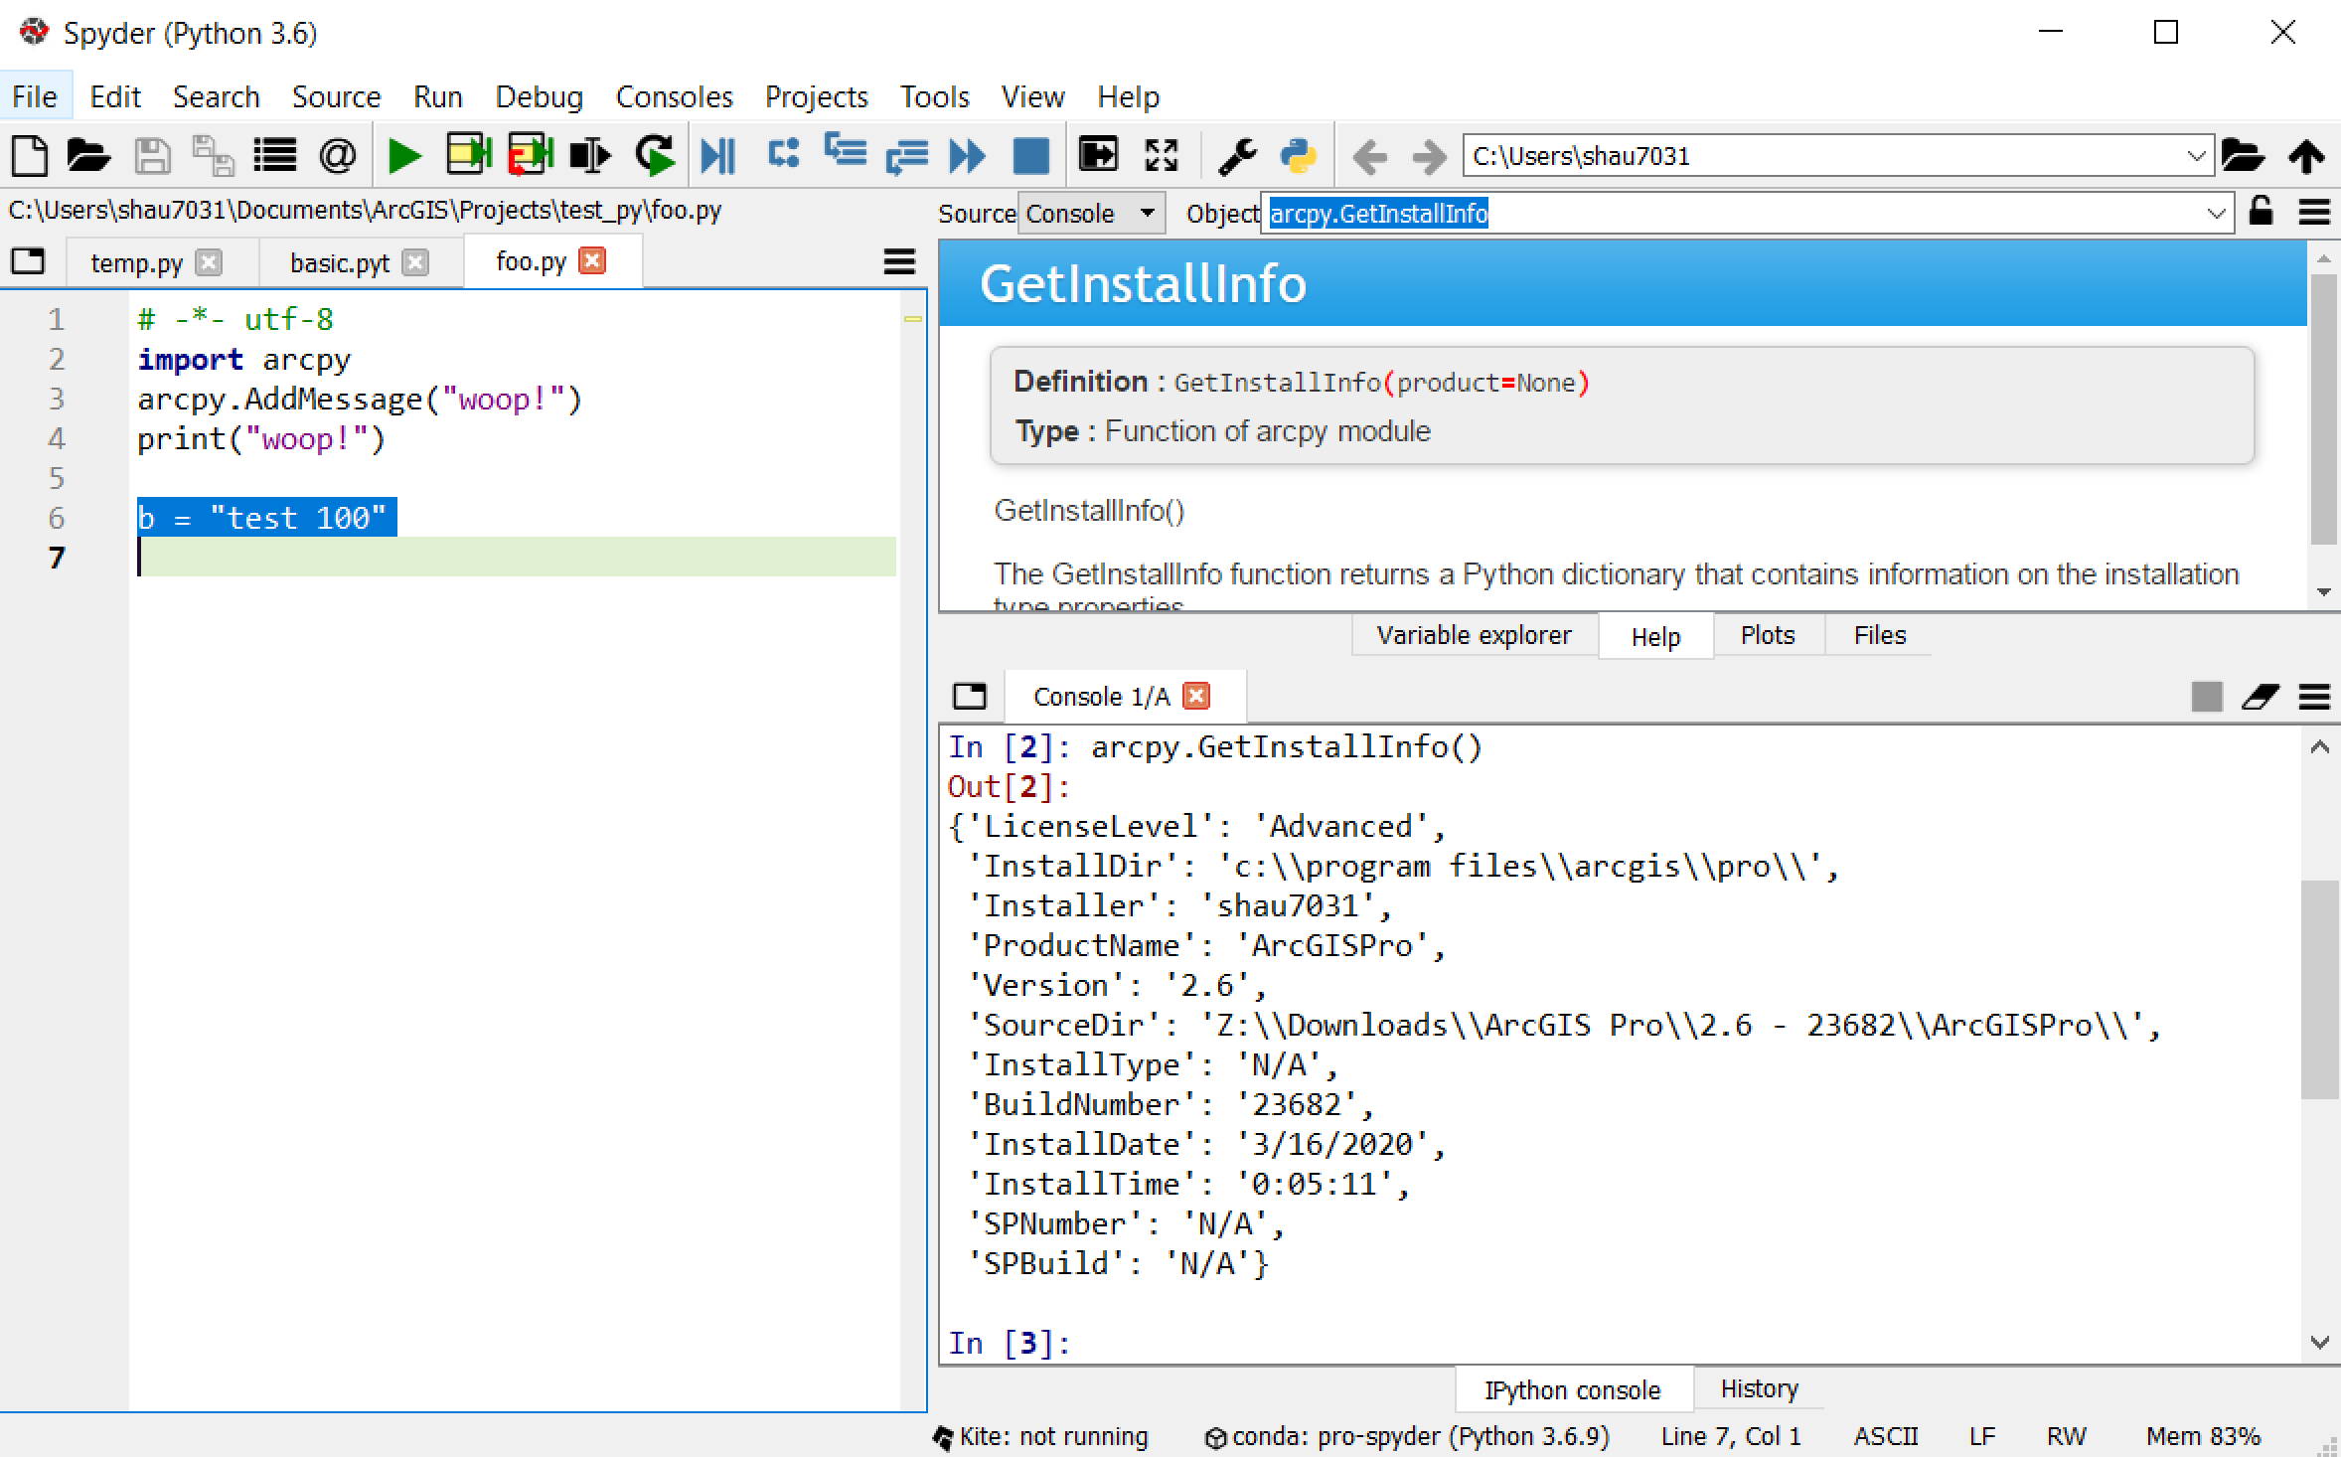
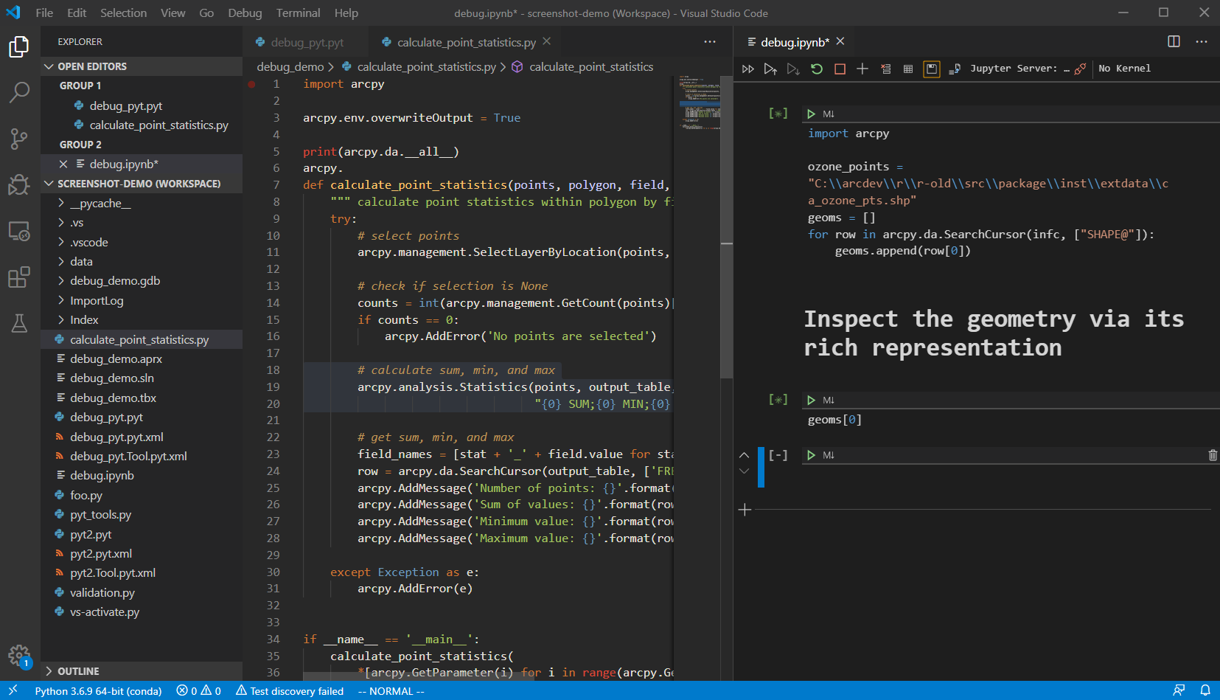
Premiere programming environment across all stacks
Spatial Data Science Workstation
Tie together with the Python ecosystem
https://anaconda.org/esri
Pro components you can use:
Notebooks
ModelBuilder
Deep Learning Libraries Installer
Python and R script tools
ArcGIS Python distribution
Conda Environments
Environment Management + Conda
ArcGIS Pro with Notebooks + Charts
Spyder
Visual Studio Code

Slide 16

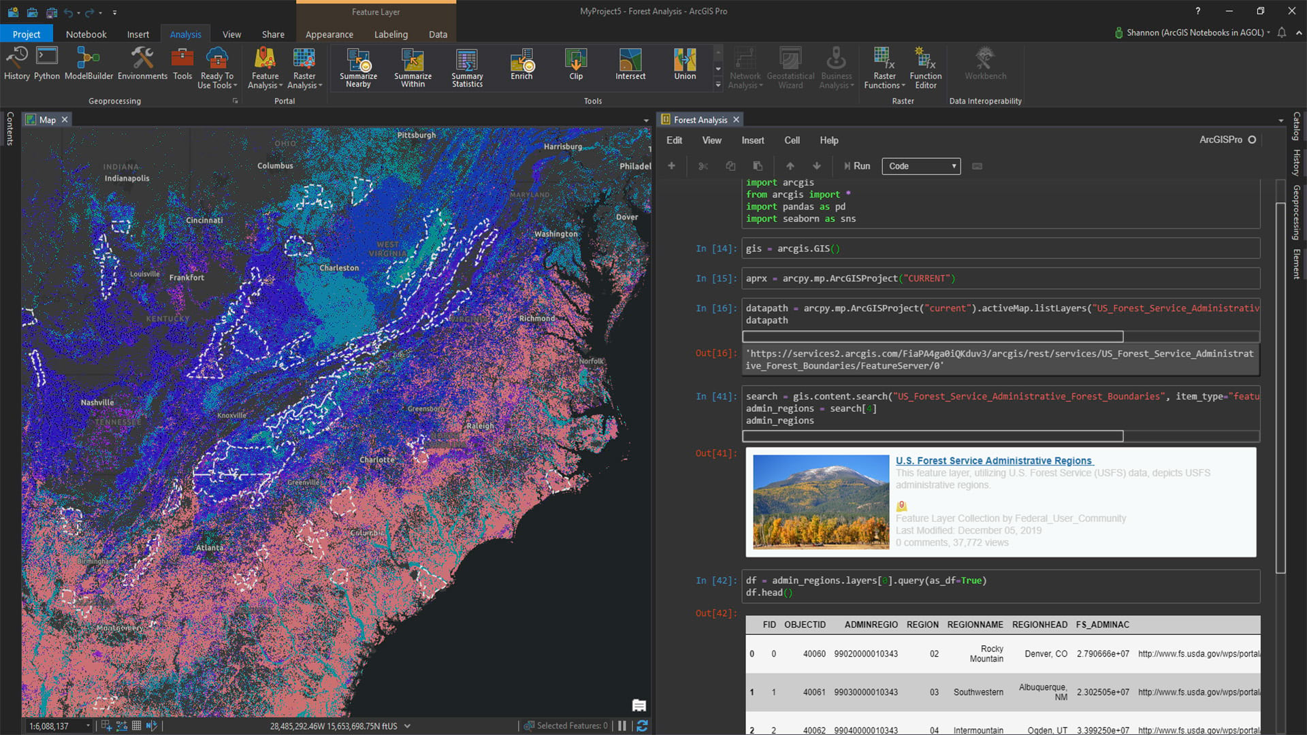
Demo - Python in the Desktop Stack
Shaun Walbridge

Slide 17
Python in the Enterprise Stack
Nanae Aubry
Portal
API for Python
Hosted Notebooks
Insights
Raster Analytics
GeoAnalytics
Enterprise

Slide 18

Demo – Introduction to ArcGIS API to Python
Nanae Aubry

Slide 19


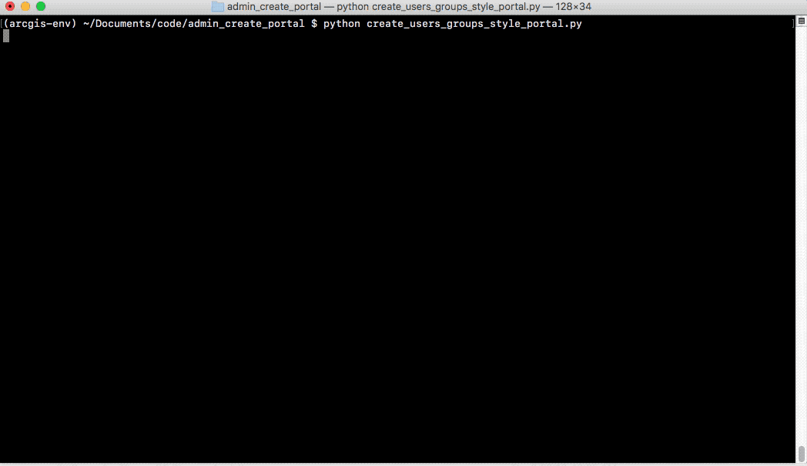
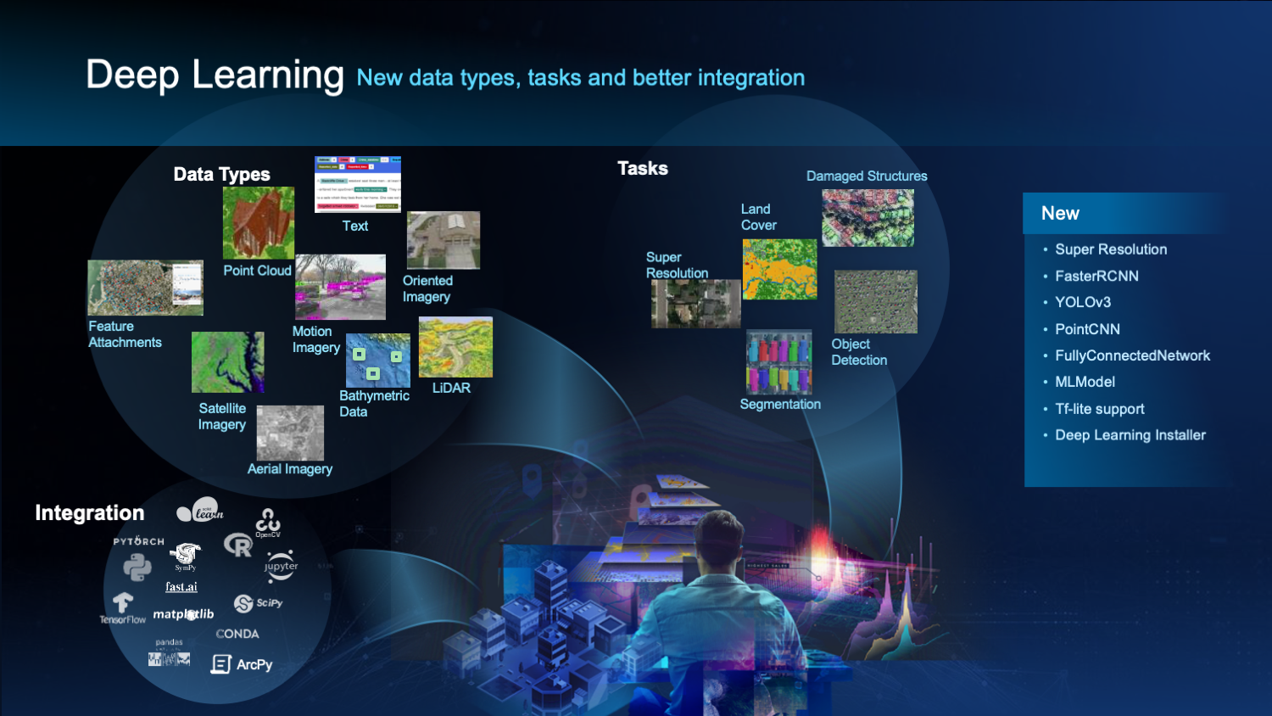
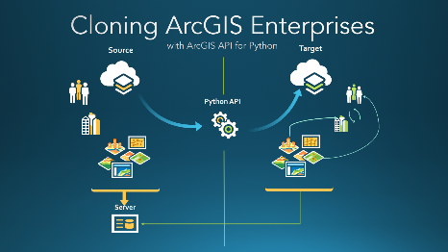
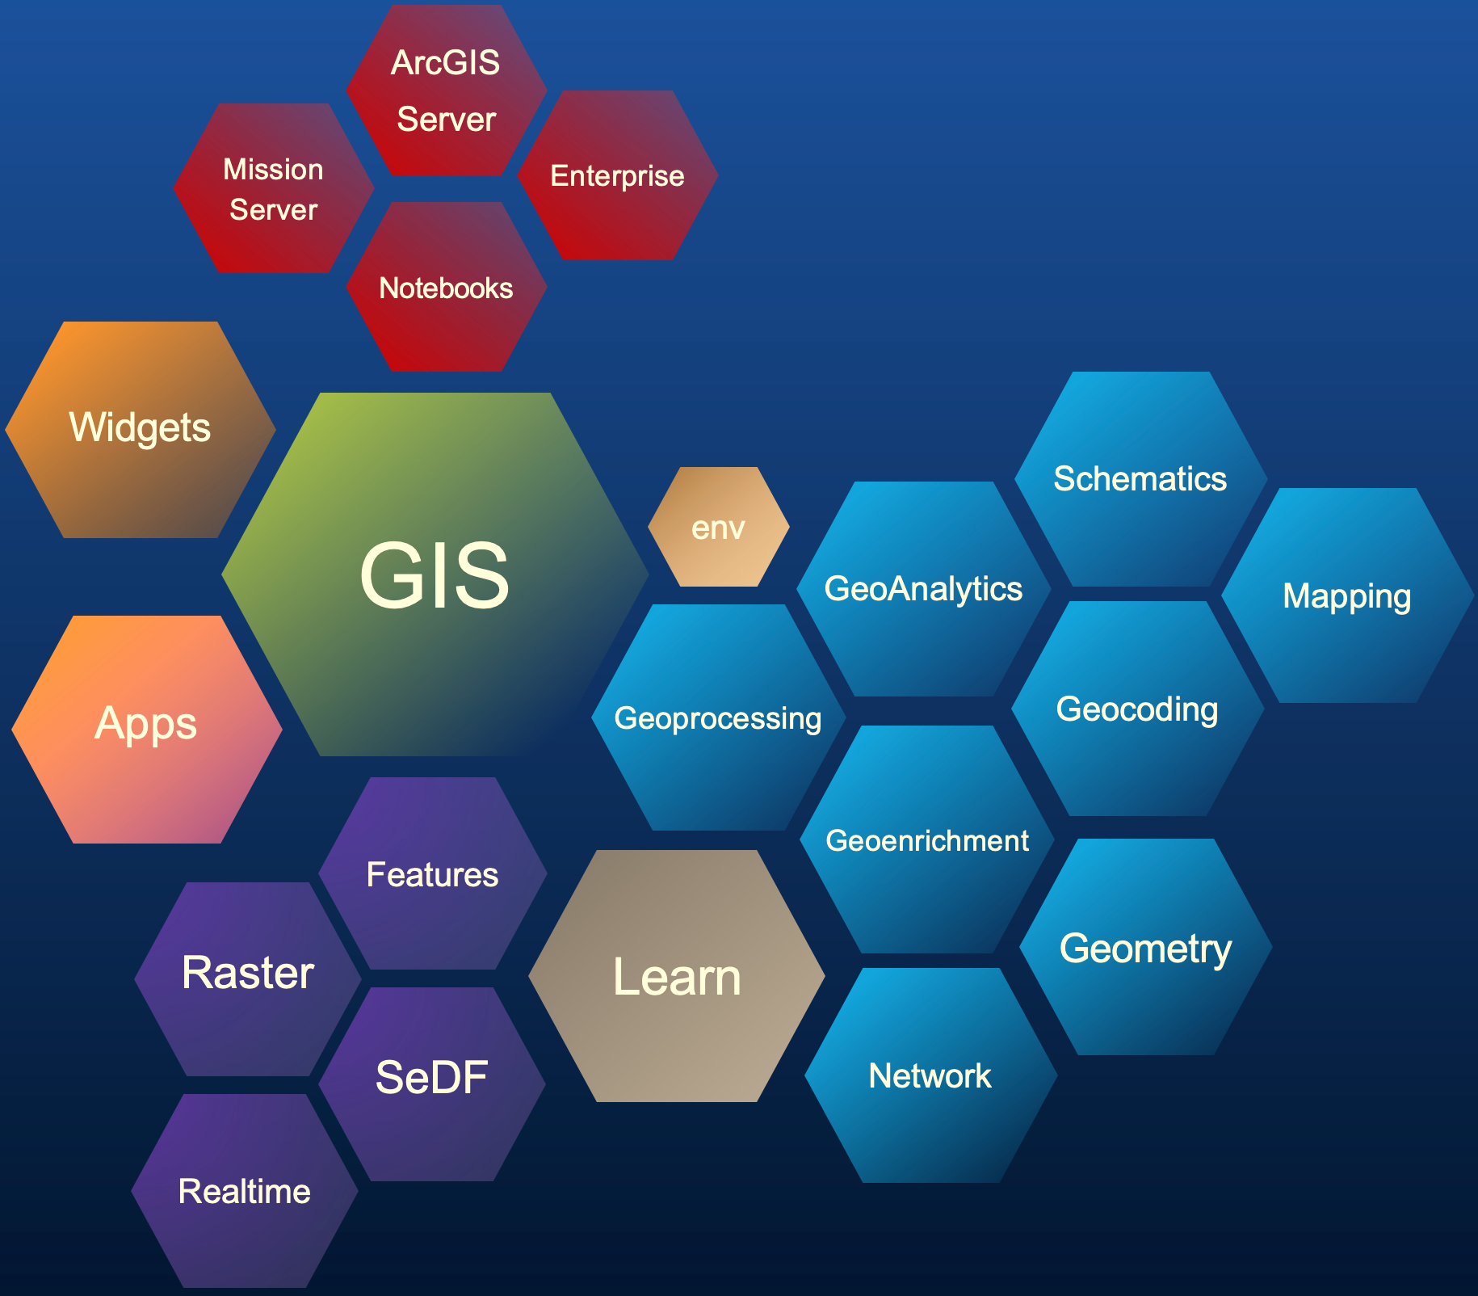
Python as remote client – Spatial Analysis and Enterprise Management
Enterprise
API for Python
ArcGIS API for Python architecture
Spatial analysis & Enterprise management

Slide 20

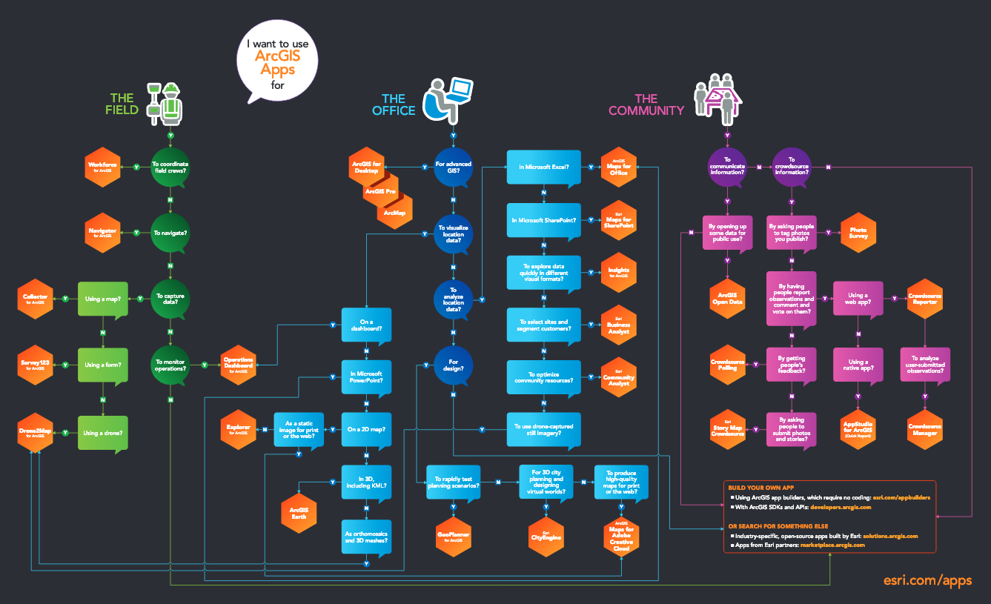




Python as remote client – automation of Platform apps
Enterprise
API for Python
StoryMaps
Customize Journal story map
Workforce
Manage Projects, assignments, dispatch
Work with attachments, tracks, workers
Survey123
Manage survey and responses
Hub
work with initiatives, events
Tracker
manage tracks, mobile users

Slide 21

Python within the Enterprise
Enterprise
API for Python
ArcPy
Notebook Server
ArcGIS Servers
+
=
+
+
+
ArcGIS
Web Adaptor
Portal
for ArcGIS
ArcGIS
Server
ArcGIS
Data Store
ArcGIS Enterprise
+
Image Server
+
GeoAnalytics
Server
Processing engines

Slide 22
Python within the Enterprise Stack – ArcGIS Servers
Enterprise
API for Python
ArcPy
ArcGIS Server
Image Server
GeoAnalytics Server
Notebook Server
Contains ArcMap and Pro runtimes
Publish models as GP services / web tools
Author tools as Python Raster Functions. Run in distributed manner
‘Run Python Script Tool’ allows you to execute custom code on GAX server
PySpark integration
Run ArcGIS API for Python and ArcPy (Linux)

Slide 23
Python in PaaS
Nanae Aubry
Online
PaaS
AWS Lambda
PaaS / SaaS

Slide 24
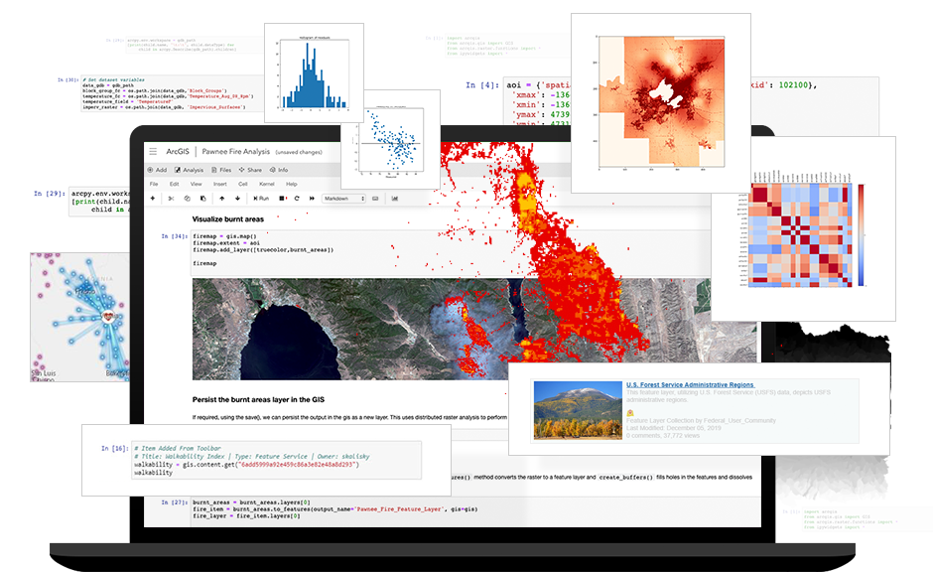























Python in ArcGIS Online
ArcGIS Notebooks – notebooks as items in your account
Benefits of SaaS – unlimited scaling, 24 x 7 availability, maintenance free
ArcPy & ArcGIS API for Python
Ready to use environment - Over 300+ libraries
On-demand GPU runtimes for training deep learning models
Share and collaborate
Notebooks in ArcGIS Online

Slide 25

Python and Platform as Service (PaaS)
Provides location services
Integrate location into your apps and business systems
Build mapping libraries of your choice
Use Esri’s full range of mapping libraries and no-code options Reduce time to market and promote creative design

Slide 26
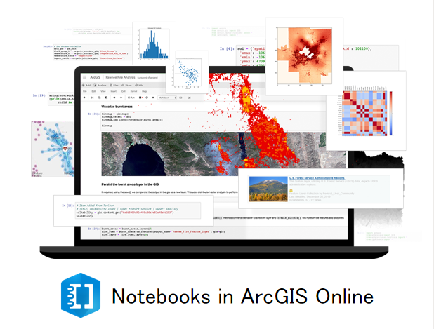
Demo – Administration with ArcGIS
Nanae Aubry

Slide 27
Python: Road Ahead

Slide 28
Python: Desktop Road Ahead
Notebooks In Pro
Access Local & hosted notebooks, interact with the map
Drag and Drop from Notebooks
Deep Learning Libraries Installer
GeoAnalytics access through PySpark
Upgrade Python environments across Pro versions

Slide 29
Python: Notebooks Road Ahead
Hosted Notebooks
Scheduling Notebooks
Notebook Server Manager
Light weight web tools
Dask Support
Parquet Support
Online Notebooks
Now available, includes free tier
GPU backed instances available

Slide 30
ArcGIS Python Libraries Road Ahead
ArcGIS API for Python
Support for distributed server deployments
Improved SSL support
arcgis.learn: improve model metrics, image detection workflows
ArcPy
ArcPy in external conda environments
Rich representations in Notebooks for all objects
Apache Arrow integration
Joint:
Better interoperability between ArcPy and the ArcGIS API for Python
Spatially Enabled DataFrames as first-class objects

Slide 31
Conclusion
Python integrates across the platform
The ArcGIS Python libraries are becoming available in more places
The Python teams continue to push the boundary in the geospatial field
The integration of the full Python ecosystem into your applications provides you the best of the open-source world and the best of what Esri builds

Slide 32

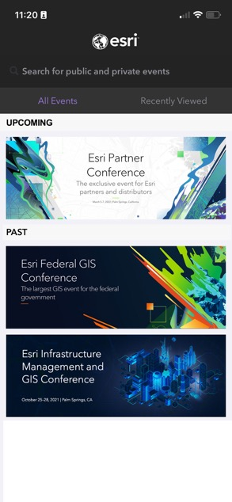
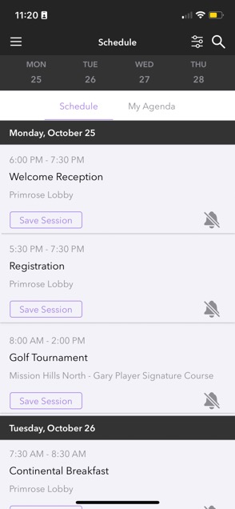
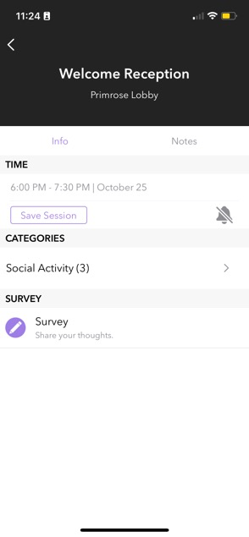
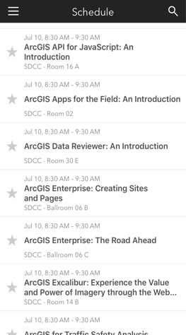

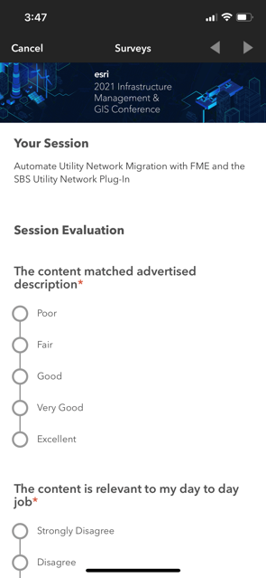
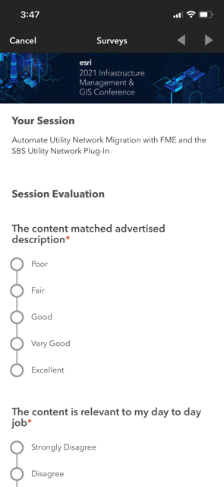

Please Share Your Feedback in the App
Please use the session survey if you have one of the following session types:
- Technical Workshops
- Expo Spotlight Talks
- Demo Theater Presentations
- SIGS
- Pre-conference Seminars
- User Presentations
Download the Esri Events app and find your event
Select the session you attended
Scroll down to “Survey”
Log in to access the survey

Slide 33


Copyright © 2023 Esri. All rights reserved.

Slide 34
2023 ESRI USER CONFERENCE

Slide 39
Copyright © 2023 Esri. All rights reserved.

